Slide 1

Real-Time Object Detection using YOLOv8
Presented By:
B Vijaya Lakshmi
Batch No: 460

Slide 2
About Me
I am a recent postgraduate in Data Science from Bankatlal Badruka College for Information Technology.
I have a strong interest in Data Analytics, Machine Learning, and Artificial Intelligence, and I enjoy using data-driven techniques to solve real-world business problems.
I have experience working with tools and technologies such as Python, SQL, data analysis libraries, and data visualization tools to analyze data, build models, and generate meaningful insights.
LinkedIn: www.linkedin.com/in/bollapalli-vijaya-lakshmi
GitHub: Vijayalakshmibollapalli

Slide 3
Agenda
Introduction to open CV
Business Problem
CRISP-ML(Q)
Tech Stack
Data Understanding
System Architecture
Challenges
Helping in Real World
Applications
Final Business Insights and Recommendations
Conclusion

Slide 4
Introduction to OpenCV
OpenCV (Open Source Computer Vision) is a widely used open-source library for image and video processing.
It helps computers understand and analyze visual information from images and videos.
It is widely used in computer vision and artificial intelligence applications.
OpenCV provides built-in functions for object detection, face detection, image processing, and video analysis.
OpenCV is popular because it is fast, efficient, and easy to use.
In this project, OpenCV is used to capture webcam video, process frames, and display detected objects.

Slide 5
Business Problem
In many places like roads, offices, malls it is important to identify objects such as people, cars, and other items.
Normally, people have to watch camera footage manually to find these objects, which can be time-consuming.
Continuous human monitoring can sometimes lead to mistakes, missed detections, or slow responses.
It is also difficult for humans to quickly identify multiple objects at the same time from images or videos.
Checking a large number of images or video recordings manually takes a lot of time and effort.
Therefore, businesses and organizations need a smart automated system that can detect objects from images or live camera video quickly and accurately.

Slide 6
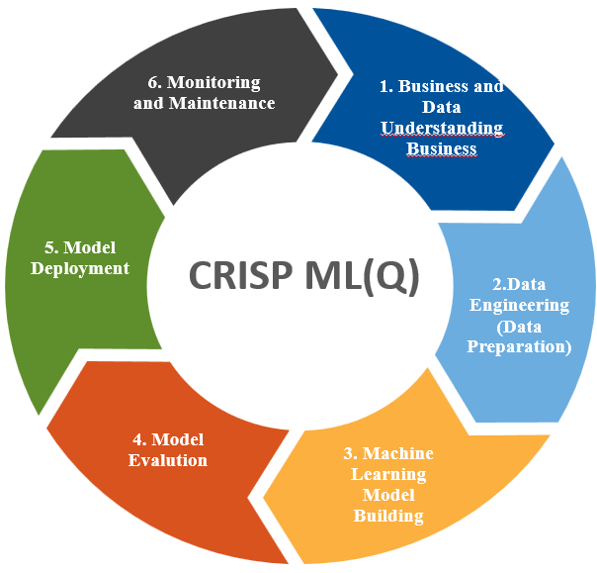
CRISP-ML(Q) Methodology
CRISP-ML(Q) is a framework used for machine learning project development.
Business and Data Understanding Identify the problem and understand the dataset.
Data Preparation
Clean and transform the data.
Modeling Learning Train the machine learning model.
Model Evaluation
Test the model performance.
Model Deployment
Implement the model in a real system.
Monitoring & Maintenance
Continuously check and improve the model.

Slide 7
Tech Stack
Programming Language: Python
Libraries:
OpenCV
Ultralytics
NumPy
Pillow
AI Model: YOLOv8
Dataset used for training: COCO Dataset
Development Environment: Jupyter Notebook

Slide 8
Data Understanding
Data Source: The system uses images and live webcam video as input.
Dataset: The model used in the project is trained on the COCO (Common Objects in Context) Dataset.
Data Type: The data consists of image files and real-time video frames captured from the webcam.
Dataset Information: The COCO Dataset contains thousands of labeled images with around 80 different object categories such as person, car, chair, laptop, mobile phone, bottle, and many others.

Slide 9
System Architecture
Input Image / Webcam
Input Image / Webcam – The system receives input through images or live webcam video.
Frame Capture – The webcam captures real-time video frames.
Image Processing – Frames are processed using OpenCV.
Object Detection – The YOLOv8 detects objects in each frame.
Object Classification – Detected objects are classified into categories like person, car, phone, chair, etc.
Bounding Box Generation – Boxes are drawn around detected objects.
Output Display – The detected objects with labels are and confidence scores are displayed on the screen.
Frame Capture using OpenCV
Image Processing
YOLOv8 Model Processing
Object Detection
Bounding Box + Label Display
Output Visualization

Slide 10
Challenges
Object Detection Accuracy – Sometimes the system may detect objects incorrectly or confuse similar objects.
Lighting Conditions – Poor or very bright lighting can affect how well objects are detected in images or video.
Camera Quality and Position – Low camera quality or improper angle can reduce detection accuracy.
Multiple Objects Detection – Detecting many objects at the same time can sometimes reduce performance.
Small Object Detection – Small or partially visible objects were sometimes difficult to detect.
Real-Time Processing – Maintaining fast detection speed during live video processing was challenging.

Slide 11
Helping in Real World
The system can automatically detect objects such as people, vehicles, and other items from images or live camera video.
It reduces the need for people to continuously watch camera footage.
It improves safety by quickly identifying objects in real time.
The system saves time and effort because it can detect many objects automatically.
It helps organizations monitor large areas more easily and efficiently.
This system can be used in places like security surveillance, traffic monitoring, smart cities, malls, airports, and other public places.

Slide 12
Applications
Used in security surveillance to detect people or suspicious objects.
Helps in traffic monitoring by detecting vehicles on roads.
Can be used in smart cities for automated monitoring systems.
Useful in public places like malls, airports, and offices for safety.
Helps analyze images and videos automatically without human monitoring.

Slide 13
Final Business Insights and Recommendations
Key insights:
AI-based object detection can automate visual monitoring systems
Real-time detection improves decision making speed
Multiple objects can be detected simultaneously
Automated systems reduce human effort and errors.
Recommendation:
Improve accuracy by training the model with custom datasets.
Deploy the system on edge devices for real-time applications.
Integrate the system with smart cameras and IoT devices.
Optimize the model to increase detection speed and performance.
Extend the project with object tracking and alert features.

Slide 14
Conclusion
The project successfully implemented real-time object detection using YOLOv8 and OpenCV.
The system can detect objects from both images and live webcam video.
It can identify multiple objects such as people, vehicles, phones, chairs, and other items.
The project shows how computer vision and Artificial Intelligence (AI) can automate object recognition tasks.
The system helps reduce manual monitoring and improves efficiency.
It can be further used in areas like security surveillance, traffic monitoring, smart cities, and public safety systems.

Slide 15
Q & A

Slide 16

THANK YOU

